Slide 1
An Example of a Rube Goldberg Machine
And the Application of Physics
Presented by: Nihal Nazeem, Kelsey McIvor, Tak Maga, and Tyler Marvier

Slide 2
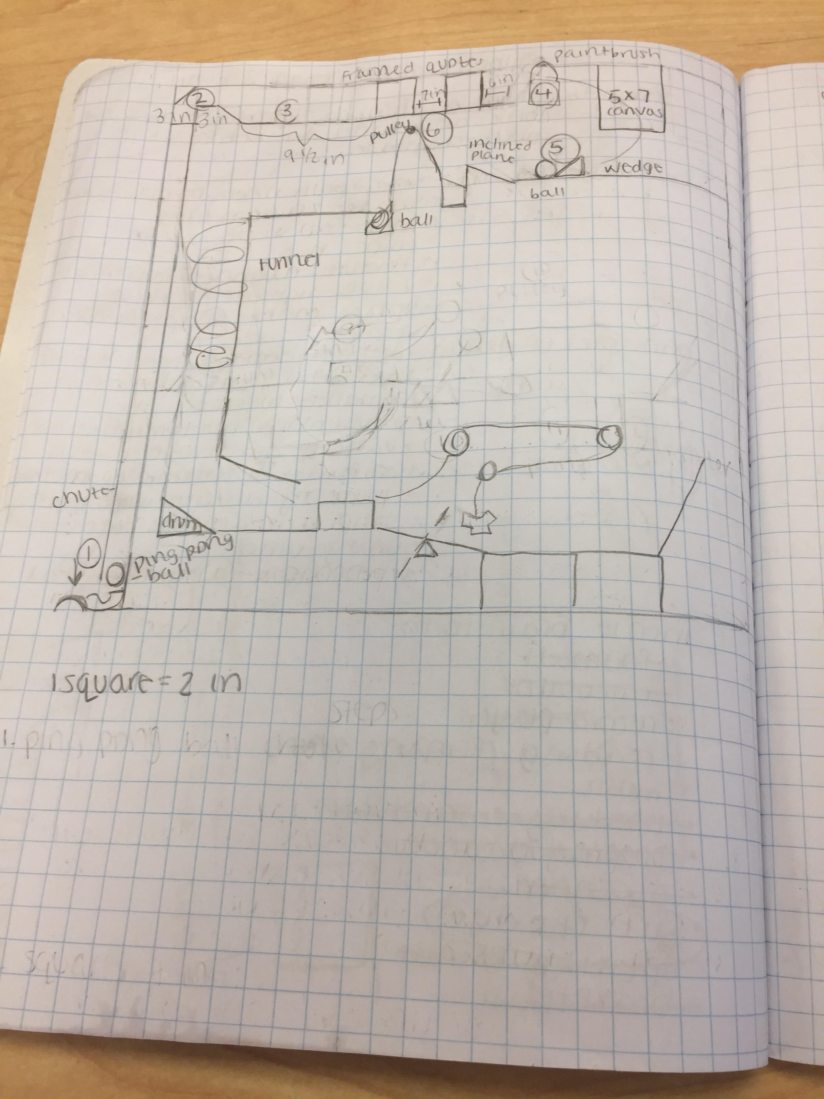

Slide 3
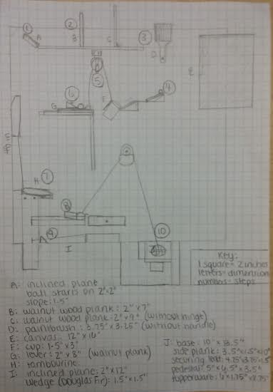

Slide 4
9 Days
To build this project

Slide 5
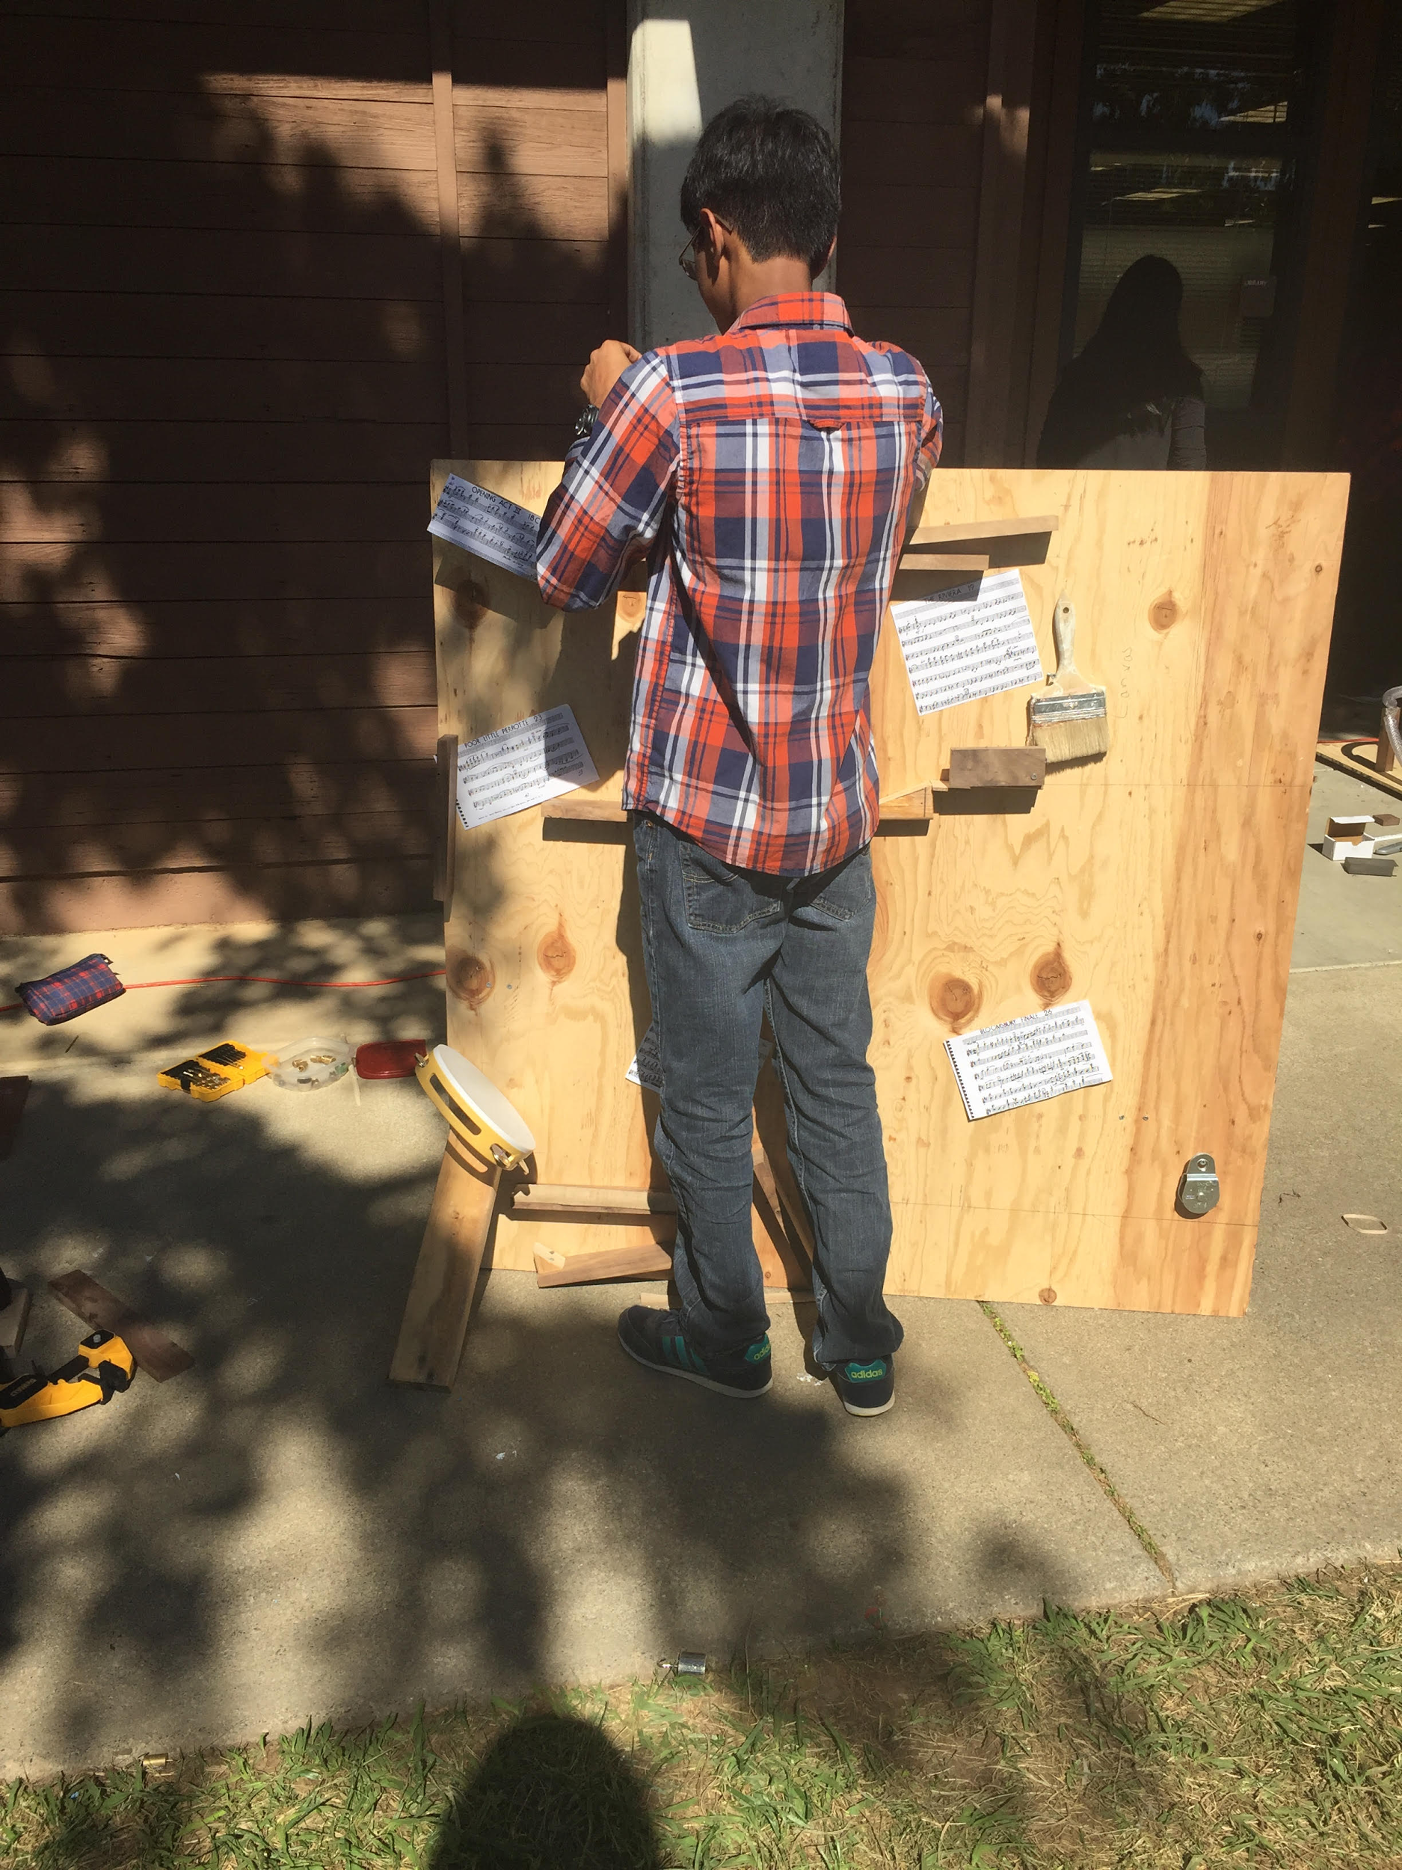

Slide 6
Building Log
Planning:
Our endeavors to construct this Rube Goldberg Machine started with the independent brainstorming of individual sequences of steps. Afterwards, we came together and decided that our theme would be “The Arts”. We each cobbled together blueprints, involving no less than twelve steps, and using an ambitious six simple machines. This, we would learn, was a mistake.
A Review of the Scientific Method in Action

Slide 7
Building Log
The next nine days that we had were used to actually construct the machine, and can be read in more detail in our construction log.
(cont.)

Slide 8
Building Log
The final three days that we had leading up to this presentation were used to finalize the project, and also to review our work in the form of calculations.
(cont.)

Slide 9
Project Details
An In-Depth Exploration of the Science Behind the Project

Slide 10
Dominos
A 26 gram spherical mass rolls down a 2 inch high inclined plane with a mechanical advantage of 1.25, colliding with a 31 gram block of walnut wood after 0.5 seconds, giving an average speed of 25 cm/s, and a loss of 0.005 J of PE due to g. The block of wood then topples, due to the toppling effect, which states that when the center of mass of an object is outside the object’s footprint (base), the object topples.Therefore, the block of wood topples, knocking the other block of wood, producing another toppling effect that moves the second block of wood forward, knocking into a paintbrush.
Notes:
A 26 gram spherical mass collides into a 31 gram block of walnut wood

Slide 11
Paintbrush
Next, the effort of the block of wood falling is applied toward the brush part of the paintbrush, making the paintbrush fall, rotating around an axle, knocking a metallic ball that will be explained in the next step. The paintbrush acts as our wheel and axle, with a mechanical advantage of 0.875.

Slide 12
Ball
The paintbrush collides with a 16.4g spherical mass that travels down 4 inches by way of an inclined plane with a mechanical advantage of 1.5, and an inclined plane with a mechanical advantage of 2. This provides enough speed to propel the mass to trigger the next step; the first pulley assembly.

Slide 13
Pulley
The first pulley has a mechanical advantage of one, meaning that the pulley alters the direction of the effort. A mass of 109.7g was used to produce a force of 1.08N to raise the opposing platform.

Slide 14
Plane and Wedge Assembly
A wedge prevents a 19.2g mass from moving across a 6 inch plane until the plane is raised to a 115 degree angle. The ball then rolls down the plane, which acts as an inclined plane with a mechanical advantage of 0.93.

Slide 15
Tambourine
The mass then falls a distance of 18 inches, accelerating at 9.8m/s squared. The average velocity is 45 inches per second. The force of the mass is 0.188N. The tambourine, at a 45 degree angle, then alters the path of the sphere to a more horizontal arc.

Slide 16
Lever Assembly
A 400g mass sits upon the left side of a class two lever. The adding of the spherical mass tips the lever to the left. The 400g mass rolls onto a waiting ramp with a mechanical advantage of 48, dragging a string.

Slide 17
Pulley and Dye
The string is pulled across a pulley with a mechanical advantage of one, raising a 43.5g cloth 4 inches.

Slide 18
Principles of Art Design
Rhythm can be found throughout the entire Rube Goldberg with our music theme, the most obvious example being a tambourine hit. The different sounds create a sort of pattern through the different beats and tempos, composing a mechanical orchestration. The entire machine has to come together with balance, the pulley and lever systems depending upon it. The constant visual movement is exhibited mainly through the balls, paintbrush, weights, and tee shirt. The variety of materials creates contrast throughout the machine, yet also helps the elements work together for harmony all surrounding the theme of music. The canvas and music sheets are the machine’s emphasis, due to the different color and texture. However, the three-dimensional design of all parts of the Rube Goldberg also are emphasized against the wood plank. These wood planks are of all different lengths with no proportional relationship, but mainly are short enough to stay on the board.

Slide 19
Reflections
By the Designers

Slide 20
Reflections
During the infancy of the project, where we had only had the theory of the machine, I was pessimistic about the true function of the machine. This was primarily due to the complexity that was involved in the creation of some of the steps and making sure that the project had fluidity. But I had my utmost faith in my group members to ensure the completion of this project. As the project progressed, the use of time, especially in the dealings of the conflicts between idealism and pragmatism, had taken a toll on our product. Under those circumstances, we realised that the work we do for the few and final days had to be the hardest, with a mindset for completion and perfection, and with this we had concluded our work on the product. Overall, I gained comfort in being more assertive, and making myself more familiar with understanding and working in a group setting.
-Nihal Nazeem

Slide 21
Reflections
The Rube Goldberg project tested our patience, collaboration, problem solving, and creativity, as well as incorporating all we have learned so far about the basics of conceptual physics. Overall, I found the machine helpful in continuing to learn about the situations in which to use the physics formulas and concepts.
The few days of preparation we had demonstrated how sometimes simplicity is key. My group was extremely determined to create a rather complex series of steps. I found it rather interesting that the groups who did decide to go with a rather uncomplicated plan ended up being the most successful. Groups with so many thoughts and goals had to eventually simplify their machine in order to get the entire project done on time. In future groups, I hope that this will be kept in mind when planning.
After having a detailed idea of what we wanted our Rube Goldberg to look like, we began construction. I feel if our time management and focus in the beginning of the project had been much higher, much less anxiety and work would have been needed outside of class. I also felt like all members of the team could have communicated better in order to have each and every person assigned and beneficially working on their own jobs and personal goals. While we definitely had ups and downs, my group worked decently well together for the majority of the month spent on creating our very own Rube Goldberg machine. -Kelsey McIvor

Slide 22
Reflections
Going into this project, I was rather relieved to to learn that some of the brightest minds that I had known in eighth grade would be in my group. I would later learn that this would bring up many problems during the building of our project. As we thought to take the best parts out of each of our individual designs and incorporate them into our main project, we did not take into account the fact that the best of our designs was most often the most complex pieces that we had to offer. Therefore, as you can see in our project, we packed together many complex systems, taking no heed of our time constraints. We should have been less ambitious, and used a lesser number of our more complex machines over a greater distance.
-Tak Maga

Slide 23
Reflections
In the duration of this project, we had to think of the best machine and then put them into one. Doing so would be rather difficult. It was an idea that looked great in our mind but was hard to accomplish in the amount of time we were provided. Our collaboration also played a role in rushing to finish.
Tyler Marvier

Slide 24
Questions

Slide 26
Building Log
Day One:
Our endeavours to construct this Rube Goldberg Machine started with the independent brainstorming of individual sequences of steps. Afterwards, we came together and decided that our theme would be “The Arts”. We each cobbled together blueprints, involving no less than twelve steps, and using an ambitious six simple machines. This, we would learn, was a mistake.

Slide 27
Building Log (cont.)
Day Two:
One the second day, we reviewed our blueprints, got them approved, and began to search for the necessary supplies in order to construct the machine. Part of our group also started to mark out the exact placement of some objects on our board.We immediately hit a couple of snags when we discovered that as we were the later class, the earlier class had already taken a number of crucial supplies.
Day Three:
On the third day, some of us made our initial foray into the land of power in order to begin the construction process in earnest. However, we may have been a bit over enthusiastic, as at the end of the day, we had achieved the affixation of no less than a single piece.
Notes:
Dark wood = walnut

Slide 28
Building Log (cont.)
Day Four:
On our fourth day, we started to make up for lost time, and affixed the initial plane of wood, and marked out the proceeding steps. We also started to brainstorm materials that could be used for the chute that we had planned to start our machine.
Day Five:
At the start of the fifth day, we attached the second “layer” of materials, including the two inclined planes coming down from the canvas, and the piece of wood immediately after the pulley. We also started to think about how to achieve our blueprint design with the first pulley.

Slide 29
Building Log (cont.)
Day Six:
Our sixth build day was mainly devoted to assembling the rest of the second layer and attempting to start on the final steps. We added the first pulley, but the assembly that goes along with it was not ready for final attachment.
Day Seven:
On our seventh build day, we began to see how little time we had left, and started to work at lunch. However, this program was interrupted by forgetful group members and conflicting schedules. We started the final lever assembly, and began to delegate the bringing of the final supplies that were still needed.

Slide 30
Building Log (cont.)
Day Eight:
On our penultimate build day, we began to cut out sections that would not work. We cut out the beginning ascension of the ball, and also decided to remove the screw channel from our complex system of supposedly “simple” machines.
Day Nine:
During our final official build day, we started to finish up the basic works of our machine, as well as starting to decorate the machine with the designs you see now. After this day, we finished the project at lunchtimes and after school, fine-tuning the details of our machine.

